Slide 1
Security Hardening – Case Study - FW
Firewall STIG
DISA, Release 22
28 April, 2017

Slide 2
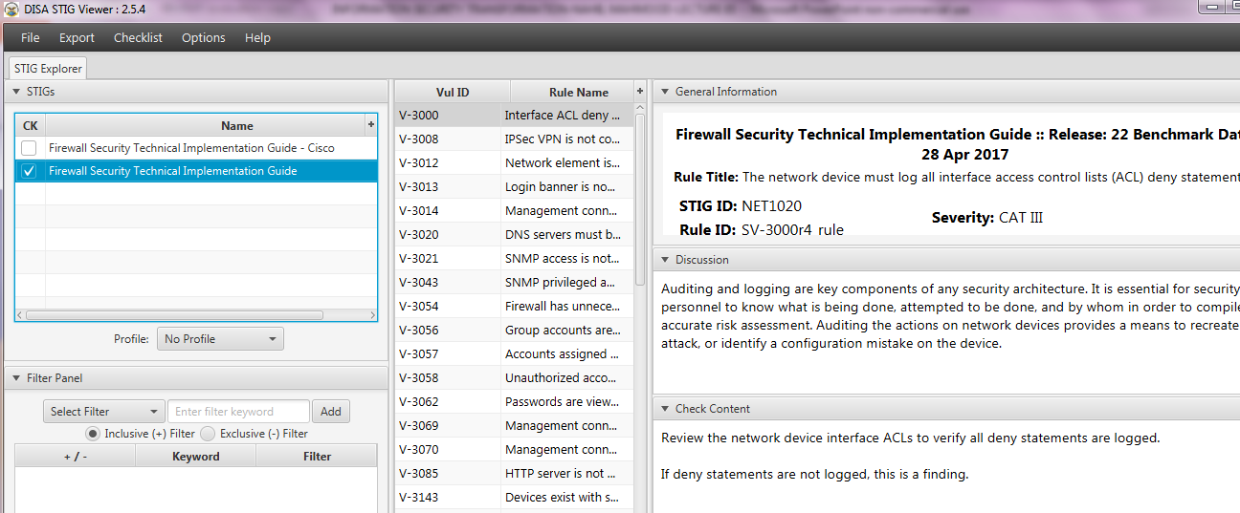
Security Hardening – Case Study - FW
STIGVIEWER WINDOW

Slide 3
Security Hardening – Case Study - FW
General Information:
Rule Title : The device must be configured to protect the network against denial of service attacks such as Ping of Death, TCP SYN floods, etc.

Slide 4
Security Hardening – Case Study - FW
General Information:
Vuln ID: V-3156
STIG ID: NET0375
Severity: CAT II

Slide 5
Security Hardening – Case Study - FW
Discussion:
A SYN-flood attack is a denial-of-service attack where the attacker sends a huge amount of please-start-a-connection packets and then nothing else. This causes the device being attacked to be overloaded with the..

Slide 6
Security Hardening – Case Study - FW
…Discussion:
…open sessions and eventually crash.
A ping sweep (also known as an ICMP sweep) is a basic network scanning technique used to determine which of a range of IP addresses map to live hosts (computers)

Slide 7
Security Hardening – Case Study - FW
Check Content:
Review the device configurations to determine if denial of service attacks guarded against.
If the device is not configured to mitigate denial of service attacks, this is a finding.

Slide 8
Security Hardening – Case Study - FW
Fix Text:
If the firewall support SYN-flood or ping sweep protection then enable these features. If the firewall does not support these features, enable the security features on the router to protect the network from these attacks.

Slide 9
Security Hardening – Case Study - FW
CCI (Control Correlation Identifier):
(Misc info)
END

